Slide 1
Trees

Slide 2
Trees
Trees are non-linear/hierarchical data structures
Trees have many things in common with their botanical cousins
root, branches, and leaves
Difference - a tree data structure has its root at the top and its leaves on the bottom.
Such a representation helps to represent hierarchical relationships.

Slide 3
Properties
Trees:
- The topmost node of the tree - root.
- The elements that are directly under an element - children.
- The element directly above node - parent.
- Elements with no children - leaves.

Slide 4
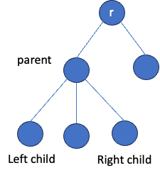
Tree Components / Concepts
Nodes
- Root
- Parent
- Child
- Leaf
Edges
Height = 2

Slide 5
Questions

Slide 6
Binary Trees
A type of tree where each node have at most two children
A binary tree
A tree (not a binary tree)

Slide 7
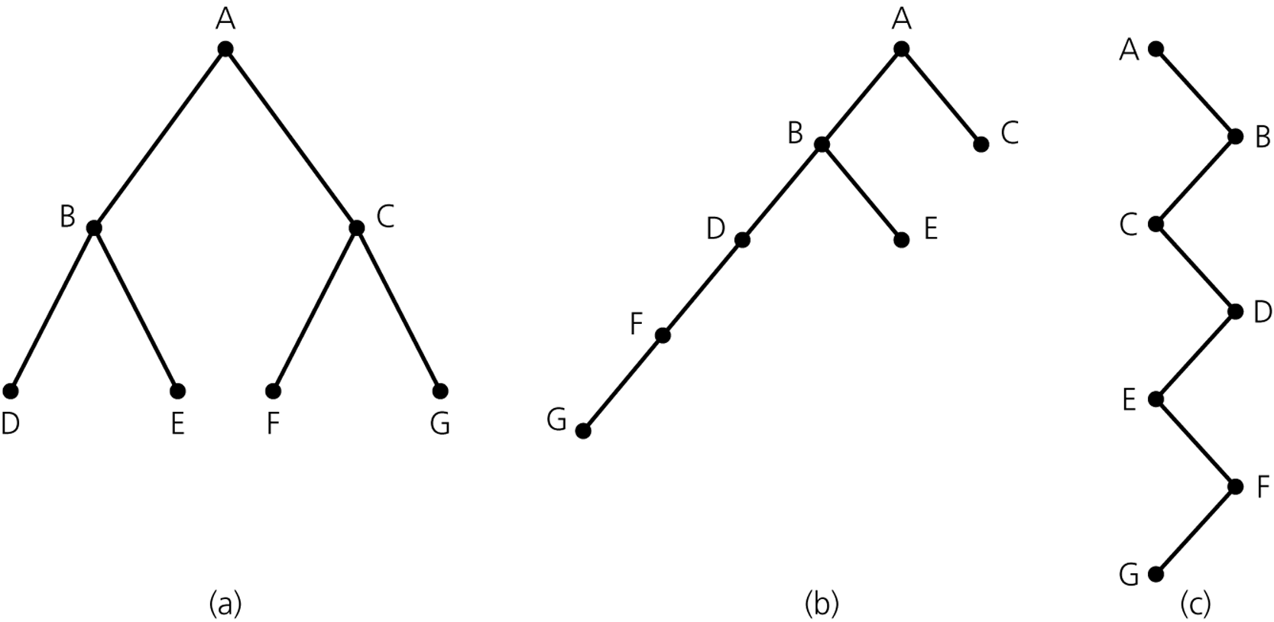
Examples
Figure 11-6
Binary trees with the same nodes but different heights

Slide 8
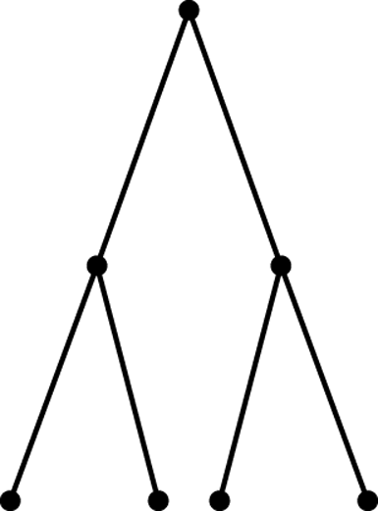
Terminology
Full, complete, and balanced binary trees
A full binary tree of height h is a binary tree in which every node has 0 or 2 children each.
Figure 11-7
A full binary tree of height 2

Slide 9
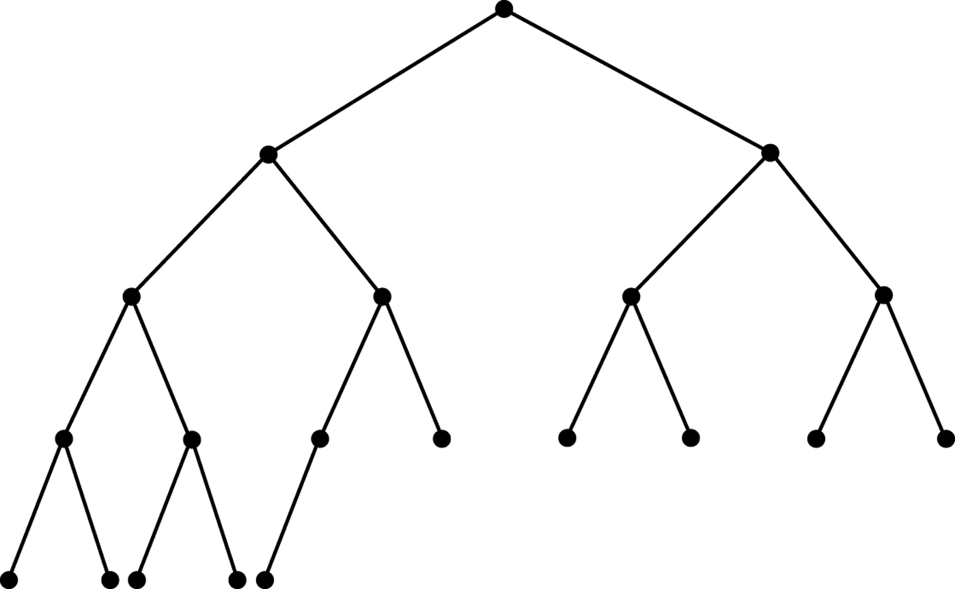
Terminology
Complete binary trees
A complete binary tree is a binary tree in which every level, except the last, is completely filled, and all nodes are as far left as possible.
A binary tree T of height h is complete if
All nodes at level h – 1 and above have two children each, and
When a node at level h has children, all nodes to its left at the same level have two children each, and
When a node at level h has one child, it is a left child
Figure 11-8
A complete binary tree

Slide 10
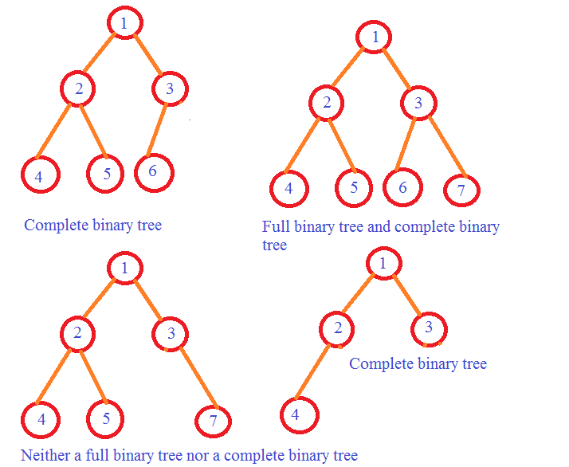
More Examples

Slide 11
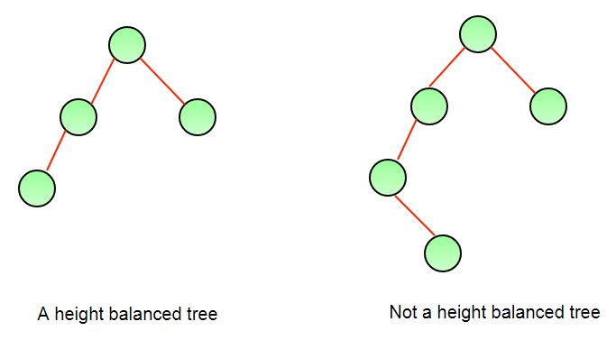
Terminology
Balanced binary trees
A binary tree is balanced if the height of any node’s right subtree differs from the height of the node’s left subtree by no more than 1
Full binary trees are complete
Complete binary trees are balanced

Slide 12
Terminology
Summary of tree terminology (Continued)
Full binary tree
A binary tree of height h with no missing nodes
All leaves are at level h and all other nodes each have two children
Complete binary tree
A binary tree of height h that is full to level h – 1 and has level h filled in from left to right
Balanced binary tree
A binary tree in which the left and right subtrees of any node have heights that differ by at most 1

Slide 13
Tree Representation
Array Based
Nodes and References Based

Slide 14
1. Binary Tree – Array based Implementation
a
Binary tree is stored in an array
Each element of the array represents a node
For any node i,
Left child is at index 2*i+1
Right child is at index 2*i+2
It’s parent is at index (i-1)/2
b
c
d
e
f
g
A binary tree
arr
a | b | c | d | e | f | g
index
0
1
2
3
4
5
6

Slide 15
Binary Tree – Array based Implementation
ArrayBinaryTree
- arr : list
+ __init__(size : int) + set_root(value : Object) + set_left(i : int, value : Object) + set_right(i : int, value : Object) + get_left(i : int) + get_right(i : int) + get_parent(i : int) + print_tree()
UML Class Diagram

Slide 16
Binary Tree – Array based Implementation
class ArrayBinaryTree: def __init__(self, size): self.arr = [None] * size # Initialization def set_root(self, value): self.arr[0] = value

Slide 17
Binary Tree – Array based Implementation (cont.)
def set_left(self, i, value): left = 2 * i + 1 if left < len(self.arr): self.arr[left] = value else: print(f"Index is out of bounds.") def set_right(self, i, value): right = 2 * i + 2 if right < len(self.arr): self.arr[right] = value else: print(f"Index is out of bounds.")

Slide 18
Binary Tree – Array based Implementation (cont.)
def get_left(self, i): left = 2 * i + 1 if left < len(self.arr): return self.arr[left] return None def get_right(self, i): right = 2 * i + 2 if right < len(self.arr): return self.arr[right] return None

Slide 19
Binary Tree – Array based Implementation (cont.)
def get_parent(self, i): if i == 0: return None # Root node has no parent parent = (i - 1) // 2 return self.arr[parent] if parent >= 0 else None def print_tree(self): print(self.arr)

Slide 20
Binary Tree – Array based Implementation (cont.)
# Example usage btree = ArrayBinaryTree(7) btree.set_root('a') btree.set_left(0, 'b') btree.set_right(0, 'c') btree.set_left(1, 'd') btree.set_right(1, 'e') btree.set_left(2, 'f') btree.set_right(2, 'g') btree.print_tree() print(btree.get_parent(4)) # Get parent of 'e' print(btree.get_parent(5)) # Get parent of 'f'

Slide 21
Pros and Cons of Array-based implementation
+ memory efficient and simple implementation
+ uses a contiguous block of memory
- Works well only for complete binary trees
- insertion, deletion, and traversal is less efficient

Slide 22
2. Binary Tree – Class based implementation
Tree nodes are represented based on objects
class TreeNode: def __init__(self, value, left, right): self.value = value self.left = left self.right = right

Slide 23
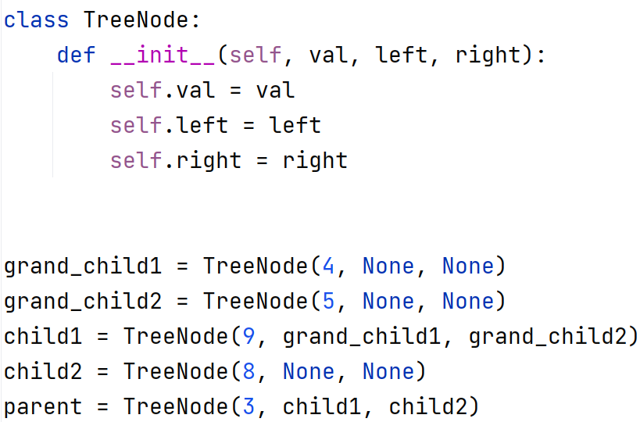
Binary Tree – Implementation Example
parent
3
child
9
8
grandchild
4
5

Slide 24
Binary Tree - Traversal
Preorder Traversal
Root
Visit the current node (root)
Visit the left subtree recursively
Visit the right subtree recursively
Left
Right
Root ---> Left ---> Right

Slide 25
Binary Tree - Traversal
Inorder Traversal
Root
Visit the left subtree recursively
Visit the current node (root)
Visit the right subtree recursively
Left
Right
Left ---> Root ---> Right

Slide 26
Binary Tree - Traversal
Postorder Traversal
Root
Visit the left subtree recursively
Visit the right subtree recursively
Visit the current node (root)
Left
Right
Left ---> Right ---> Root

Slide 27
Preorder Traversal – Python Implementation
def traversePreOrder(node): print(node.value) if node.left != None: traversePreOrder(node.left) if node.right != None: traversePreOrder(node.right)
3
9
8
Output: 3 > 9 > 4 > 5 > 8
4
5

Slide 28
Inorder Traversal – Python Implementation
def traverseInOrder(node): if node.left != None: traverseInOrder(node.left) print(node.value) if node.right != None: traverseInOrder(node.right)
3
9
8
Output: 4 > 9 > 5 > 3 > 8
4
5

Slide 29
Postorder Traversal – Python Implementation
def traversePostOrder(node): if node.left != None: traversePostOrder(node.left) if node.right != None: traversePostOrder(node.right) print(node.value)
3
9
8
Output: 4>5>9>8>3
4
5

Slide 30
Exercise:
Find out the preorder, inorder, and postorder traversal results for the
following binary tree:
a
b
c
d
e
f
g

Slide 31
Attendance

